Slide 1
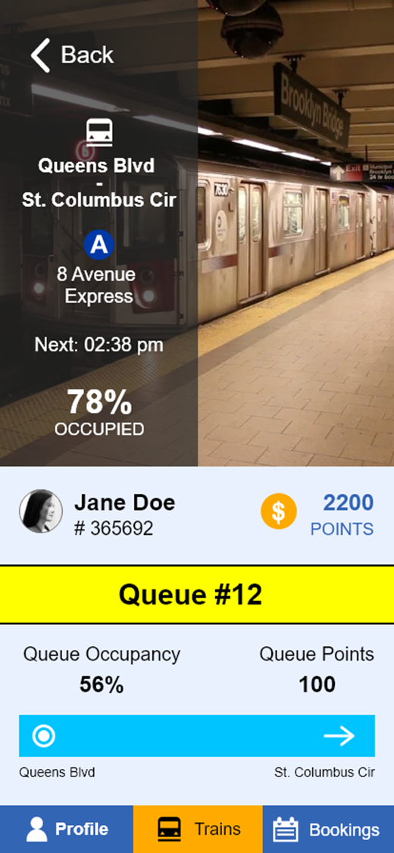
Algorithmic Mechanism Design lets you align the interests of each person with the common good.
Smart Queue
Make people part of the solution,
not the problem.

Slide 2
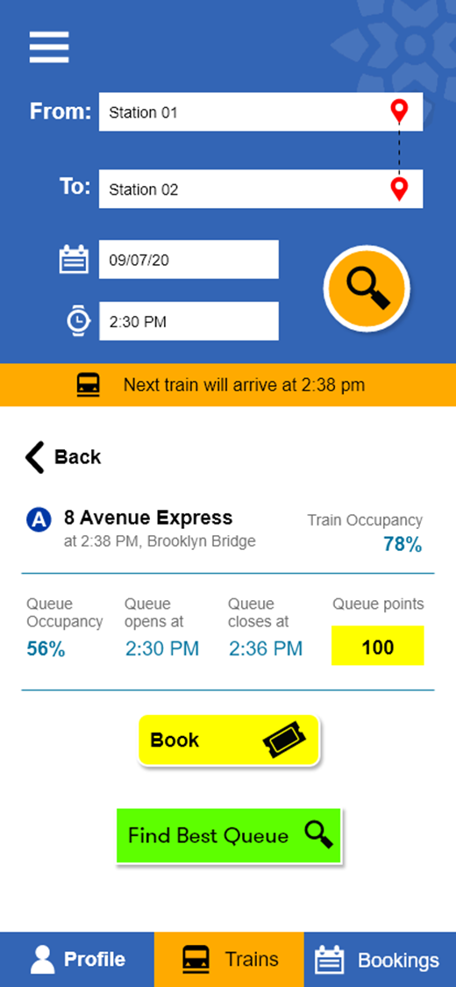
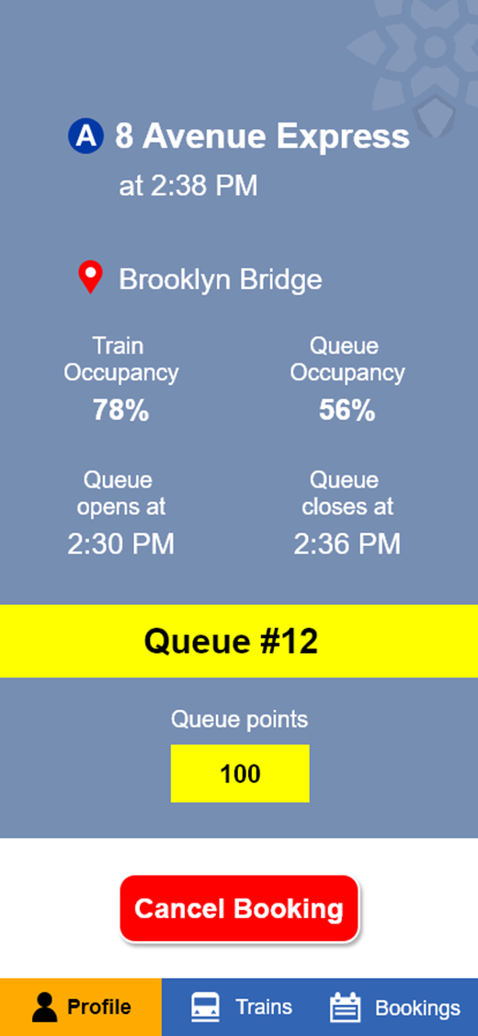
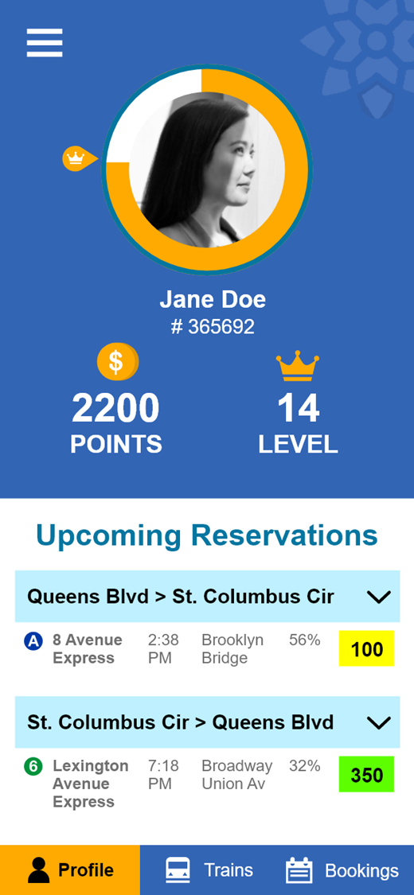
monitors the complex transit network and offers each rider real-time rewards for willingly keeping a safe social distance.
The Smart Queue
Smart Queue
Make people part of the solution,
not the problem.

Slide 3
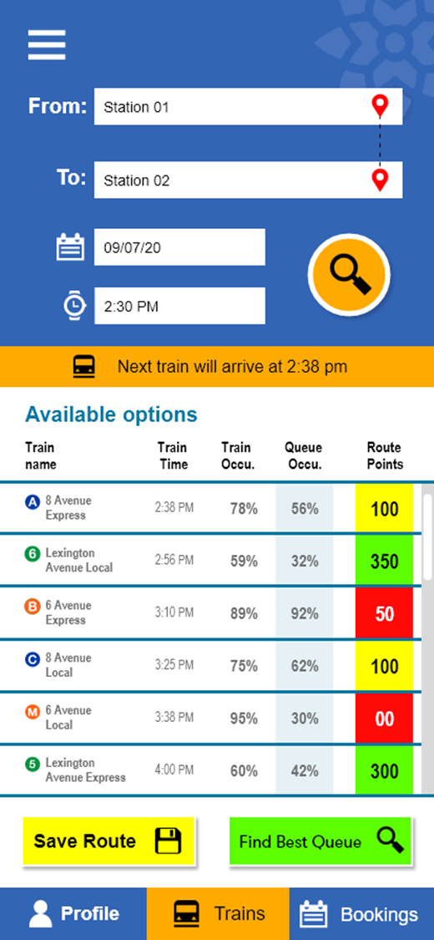
Smart Queue
Instead of imposing travel restrictions, we gave people incentives to look out for each other.
Make people part of the solution,
not the problem.

Slide 4
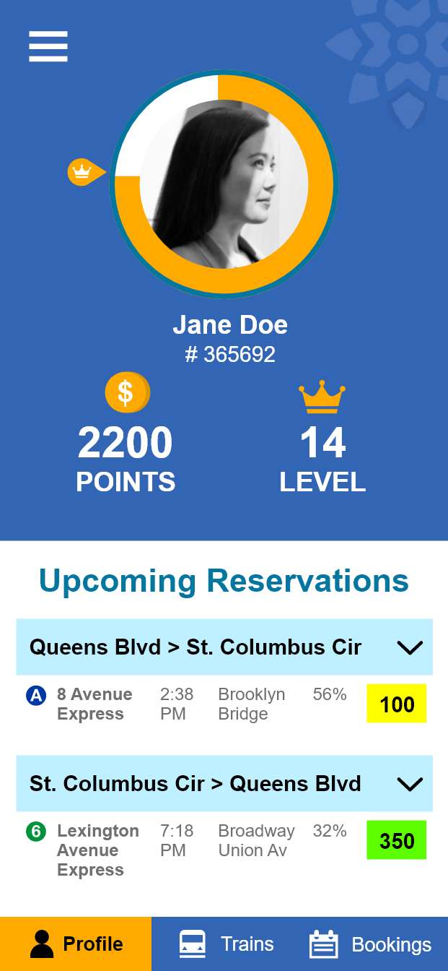
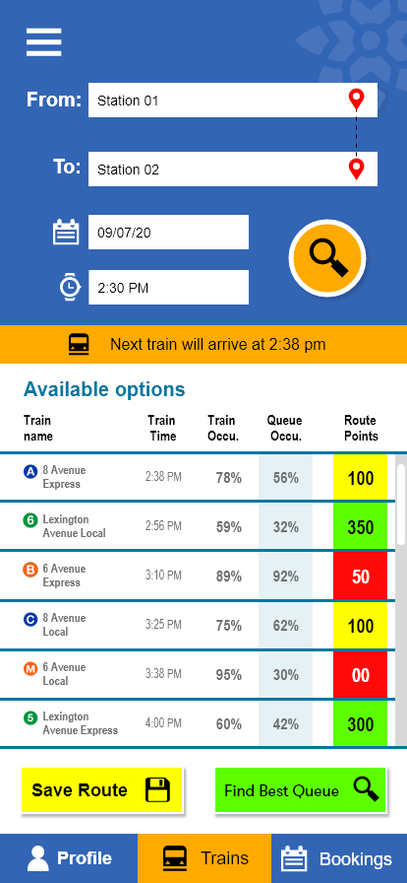
Smart Queue
Make people part of the solution,
not the problem.

Slide 5


Diwakar
Mabry
Mobile Device
Azure Web App
Simulated
Could be deployed as smart contract running on the Blockchain
Req: HTTPS
Res: JSON
Req: HTTPS
Res: JSON
Smart Queue (Django App)
MTA IoT (API)
Flutter App
MTA Data (API)
Req: HTTPS
Res: JSON
Req: HTTPS
Res: JSON
Azure Database for PostgreSQL
Azure Web App
PostgreSQL DB
Queue Schedule (JSON)
MTA Schedule (Tables)
Req: HTTPS
Res: JSON
Queue Schedule Creator (Django App)
Smart Queue
Abhishek
Abhinav

Slide 6

Smart Queue App Demo

Slide 7






The Smart Queue (Team 16)
Business Goals
Team and Roles
Content Library
Business Value: We make it safer to use any public facility. Rather than predicting and restricting, we incentivize people (with a gaming experience) to look out for each other.
Data Scientist Abhishek Kumar | akumar2109@dxc.com (Applied AI CoE Intern & Drexel Student)
GitHub Repo: Click Here
Developer Diwakar Reddy Peddinti | dpeddinti@dxc.com (Applied AI CoE Intern & Drexel Student)
Video: Click Here
Technical Innovation: Algorithmic mechanism design is an under-used technique. We used it to reward those who willingly social distance.
Developer Faine Mabry Fonseca | ffonseca20@dxc.com (Applied AI CoE Intern & Drexel Student)
Presentation: Click Here
Developer Abhinav Chaudhary | achaudhary42@dxc.com (Applied AI CoE Intern & Drexel Student)
Code: Click Here
Business implementation: The application uses Microsoft Azure’s native cloud services and scale. Production implementation is a matter of customizing, deploying, and testing.
AI/ML Expert Jerry Overton | joverton@dxc.com (Applied AI CoE Director)
Data Sources: Click Here
Designer Hitesh Kumar | hkumar34@dxc.com (Applied AI CoE Design Lead)
App Demo: Embedded in Presentation

